Slide 1
IT Refresh Program
Summer 2014

Slide 2
Issue Tracking
Version Control
Integrated Testing
Availability Monitoring
Continuous Deployment
Secure Development

Slide 3
Version Control
Subversion
GUI: SVN
IDE: Visual Studio
Git (http://172.22.164.52)
Command Line (git)
GUI: Github App, SourceTree
IDE: Eclipse, Xcode, etc.
Editors: Sublime Text, Atom

Slide 4
Testing
Unit Testing
http://coderdiaries.com/2014/03/02/mspec-over-mstest-nunit/
Test (e.g., NUnit, JUnit, etc.)
Specification (e.g., MSpec, NSpec, etc.)
System Testing
Tools (Web: Watir Webdriver, Selenium Webdriver)
Specification (e.g., MSpec, NSpec, etc.)
Build Tools (for multiple test files)
Cake, Rake, Maven, etc.

Slide 5
Continuous Integration
Version Control + Unit Testing

Slide 6
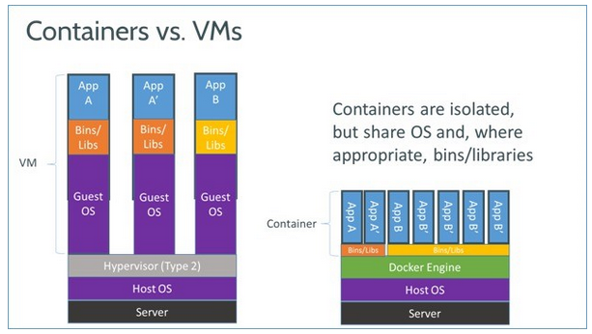
Continuous Delivery
source: http://www.zdnet.com/heres-how-microsoft-is-supporting-the-open-source-docker-container-model-7000030393/

Slide 7
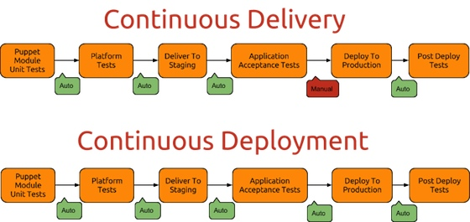
Delivery vs. Deployment
source: http://puppetlabs.com/blog/continuous-delivery-vs-continuous-deployment-whats-diff

Slide 8
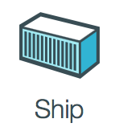
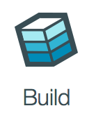


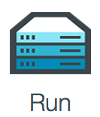
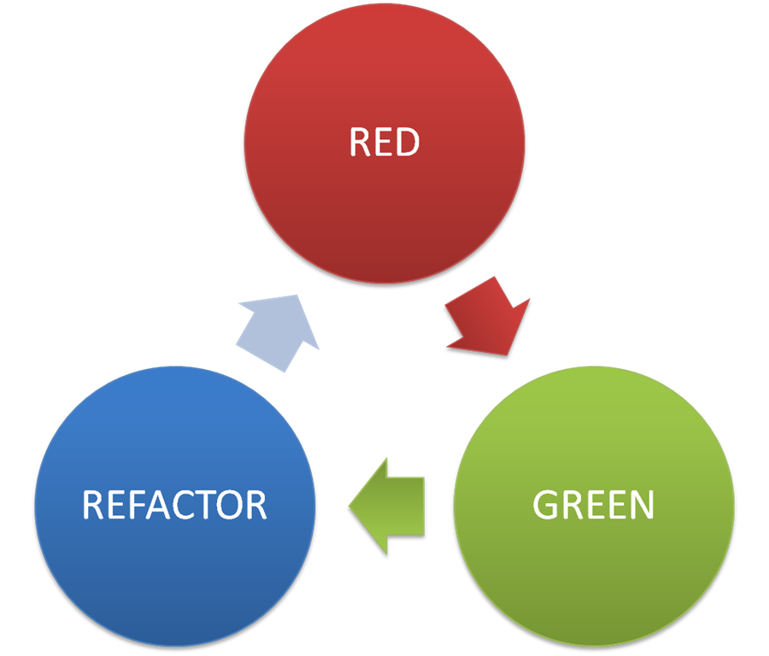
Start
Test
Develop
Refactor

Slide 9
Solutions Capability
Needs Assessment
Identifying IT Weaknesses
Identifying Potential Bottlenecks
Identifying Future Candidates
Testing Regimen
Test Driven Development
Continuous Integration
Behavior Driven Development
Platform Awareness
Programming Languages
Development Paradigms
Solution Architectures
Continuous Deployment
Canisterized Deployment
DevOps Paradigm
New Solutions
Solution Ideation
Prototyping
Continuous Learning
Dev Community Awareness
Online Learning Tools
Workshops and Seminars
Development
Operations
Process Maturity
Continuous Learning

Slide 10
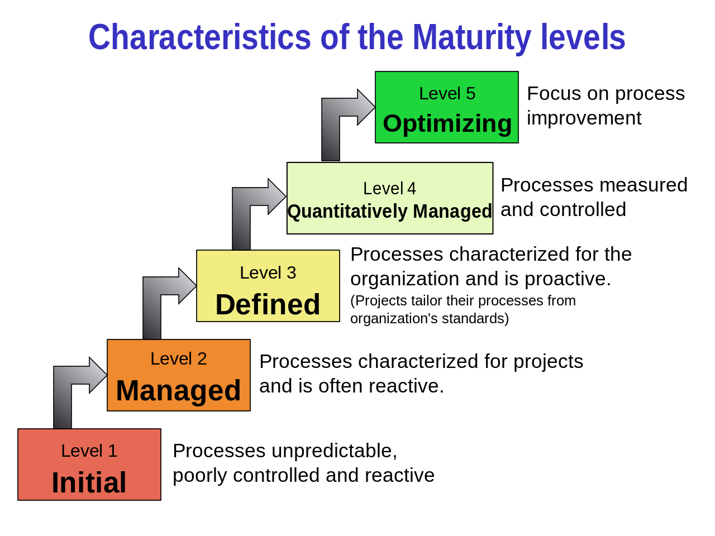
https://en.wikipedia.org/wiki/Capability_Maturity_Model_Integration

